Slide 1

Department of Computer Science Gujarat University
5 Year Integrated M.Sc.(Computer Science)
Semester - VI
Bhagawad Geeta LLM
Presented By:
Vedant Dave(05)
Under the Guidance of :
Dr. Suchit Purohit

Slide 2
Introduction
My research project, represents an innovative intersection of technology and spirituality, harnessing the wisdom encapsulated within the Bhagavad Gita to enhance natural language processing capabilities. The Bhagavad Gita, an ancient Indian scripture, is a profound philosophical discourse embedded within the epic Mahabharata.

Slide 3
Research Problem
How can the linguistic and philosophical insights contained within the Bhagavad Gita be effectively integrated into a language model to enhance natural language understanding and foster spiritual exploration?
The main motivation behind building this model is to preserve cultural and philosophical values of Shrimad Bhagavad Gita and pass the timeless knowledge to future generations without spending time reading the whole book.

Slide 4
Objectives of Research
Linguistic Enrichment: By incorporating the teachings and language patterns of the Bhagavad Gita into our LLM, we seek to enrich the model's understanding of complex philosophical concepts, ethical dilemmas, and human experiences.
Cultural Preservation: The Bhagavad Gita holds immense cultural and spiritual significance, serving as a cornerstone of Hindu philosophy. Llama2 7b endeavors to preserve and propagate this cultural heritage by digitally preserving its wisdom and making it accessible in contemporary contexts.
Spiritual Exploration: Beyond linguistic advancements, our project aspires to foster a deeper understanding and appreciation of spiritual teachings. By delving into the Bhagavad Gita, we aim to facilitate introspection, personal growth, and philosophical contemplation among users.

Slide 5
Objectives of Research
4. Cross-Cultural Understanding: Investigate how the incorporation of teachings from the Bhagavad Gita into the language model can facilitate cross-cultural understanding and bridge linguistic and philosophical gaps between different communities.
5. Long-Term Impact: Evaluate the long-term impact of integrating spiritual teachings into language models on society, including potential effects on individual well-being, cultural preservation, and the evolution of AI-driven communication and decision-making processes.

Slide 6
Literature Review
Year | Title | Hindu Document | Framework | Remarks
2023 | MahabharatAI | Mahabharat | ChatGPT-3 | Able to generate in different languages due to gpt's architecture, uses gradio for building the UI and pinecone as vector store.
2024 | GitaGPT | Bhagvad Gita | ChatGPT-3 | Supports and generates 16 indian languages, can interpret sanskrit written shlokas and give actual meaning, generate same answer everytime for the same question, reduced hallucination.
2024 | Ramayan-GPT | Ramayan | ChatGPT-3 | Answers don't mismatch for same questions, doesn't support/generate other languages, UI is bad.
2023 | Vedic-Wisdom GPT | Vedas | ChatGPT-3 | Requires paying, has a large database vedas, can generate in other indian languages.
2022 | Topic modelling between Bhagvad Gita and Upanishad | Bhagvad Gita and Upanishad | BERT | Map those topics of the Bhagavad Gita and the Upanishads, analyse overlapping of topics between those two texts. Model gives a coherence score of 73% on the Bhagavad Gita and 69% on the Upanishads.
2023 | Generative AI Language Model Interpret Cultural Heritage Values | Cultural Heritage(General) | ChatGPT-3 | Suggests uses of chatgpt to interpret cultural and heritage values.
2021 | Sanatan Dharma Chatbot | Bhagvad Gita, Vedas, Puranas, Yoga, Gayatri Mantra, Vedic Interpretations, Upanishads | ChatGPT-3 | This includes majorly all text viz. bhagvad gita, upanishads, puranas, ramayan, mahabharat,… in its knowledge base. It can generate in other languages also can generate sanskrit shloka and interpret its meaning. Even displays sources from where it took the information.
2021 | Sanjaya Chatbot | Mahabharat | ChatGPT-3 | Has buttons for quick querying. Can generate verses in sanskrit and also has facility for generating the shloka from a particular chapter/line.

Slide 7
Literature Review

Slide 8
Literature Review

Slide 9
Research Methodology
Introduction
This research methodology outlines the systematic approach adopted to develop an LLM Model on the Bhagavad Gita utilizing LLama2 7b. The methodology encompasses data collection, processing, analysis, and ethical considerations to ensure the validity and reliability of the research findings.
2. Research Design
The research design involves employing computational linguistics techniques to analyze the textual content of the Bhagavad Gita. LLama2 7b, a sophisticated software tool known for its text analysis capabilities, serves as the primary framework for developing the LLM Model. This approach allows for a systematic exploration of the linguistic features and thematic elements present in the sacred text.

Slide 10
Data Collection
The data collection process for developing an LLM Model on the Bhagavad Gita using LLama2 7b involves gathering digital version of the sacred text to ensure a comprehensive and representative dataset.
Selection of text resource: For this project, Bhagvad Gita As It Is from A.C. Bhaktivedanta Swami is used.
Criteria for inclusion: Textual sources are evaluated based on criteria such as linguistic accuracy, fidelity to the original Sanskrit text, scholarly reputation, and cultural significance.
Data Acquisition: Digital versions of the selected texts are acquired from online repositories, academic libraries, digital archives, and reputable websites specializing in religious texts.

Slide 11
Data Analysis/Preprocessing
Standardization: Standardization involves tasks such as normalization of spelling variations, punctuation removal, and formatting alignment to facilitate accurate analysis.
Noise Removal: Noise removal techniques include filtering out footnotes, annotations, and textual commentary that are not part of the original Bhagavad Gita verses.
Tokenization: Tokenization ensures that each linguistic element is treated as a separate unit for analysis, allowing for precise measurement of word frequencies and linguistic patterns.
Storage: Each word is converted to a vector embedding using HuggingFaceEmbedding and stored in a vector store FAISS (Facebook AI Similarity Search)

Slide 12
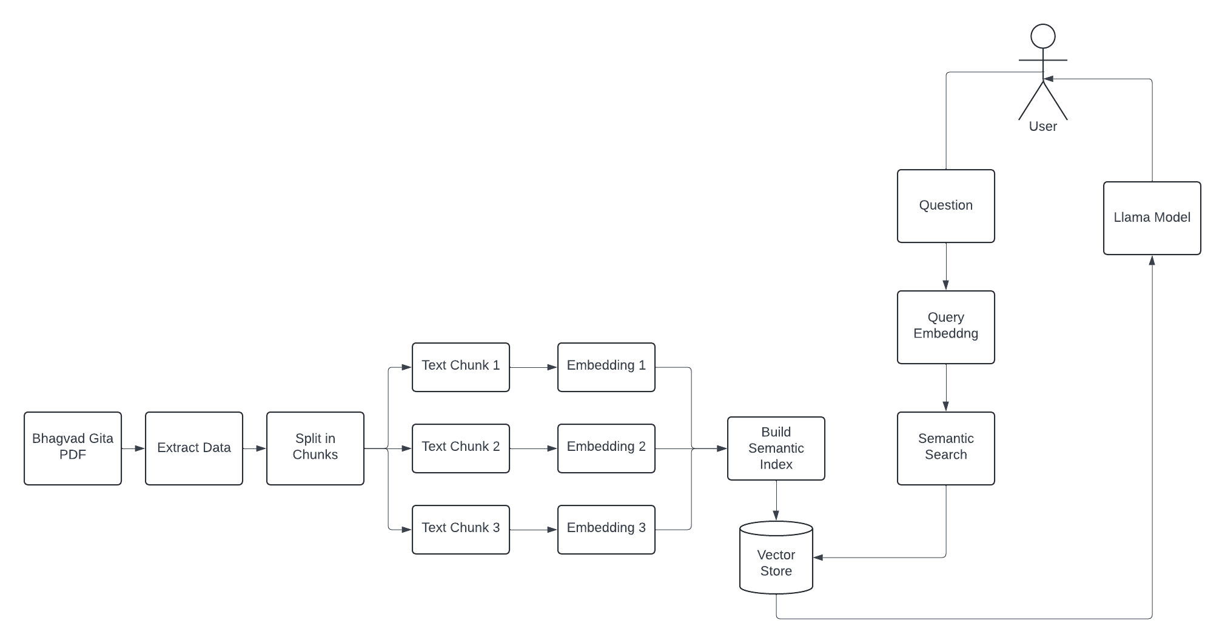
Working of Model

Slide 13
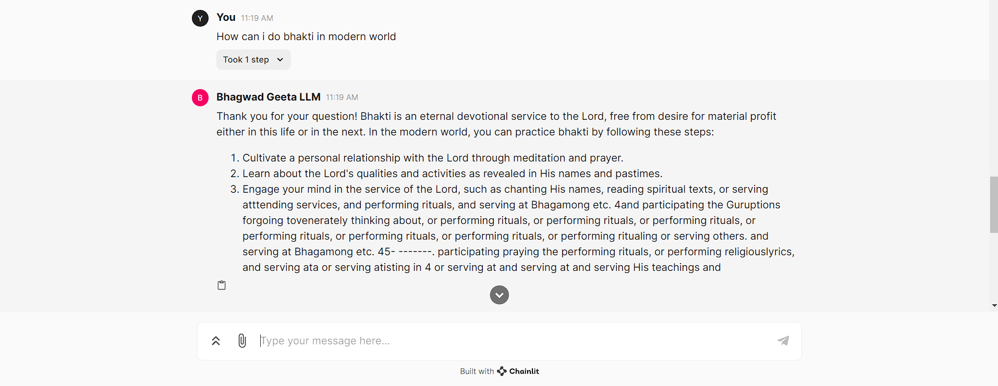
Implementation

Slide 14
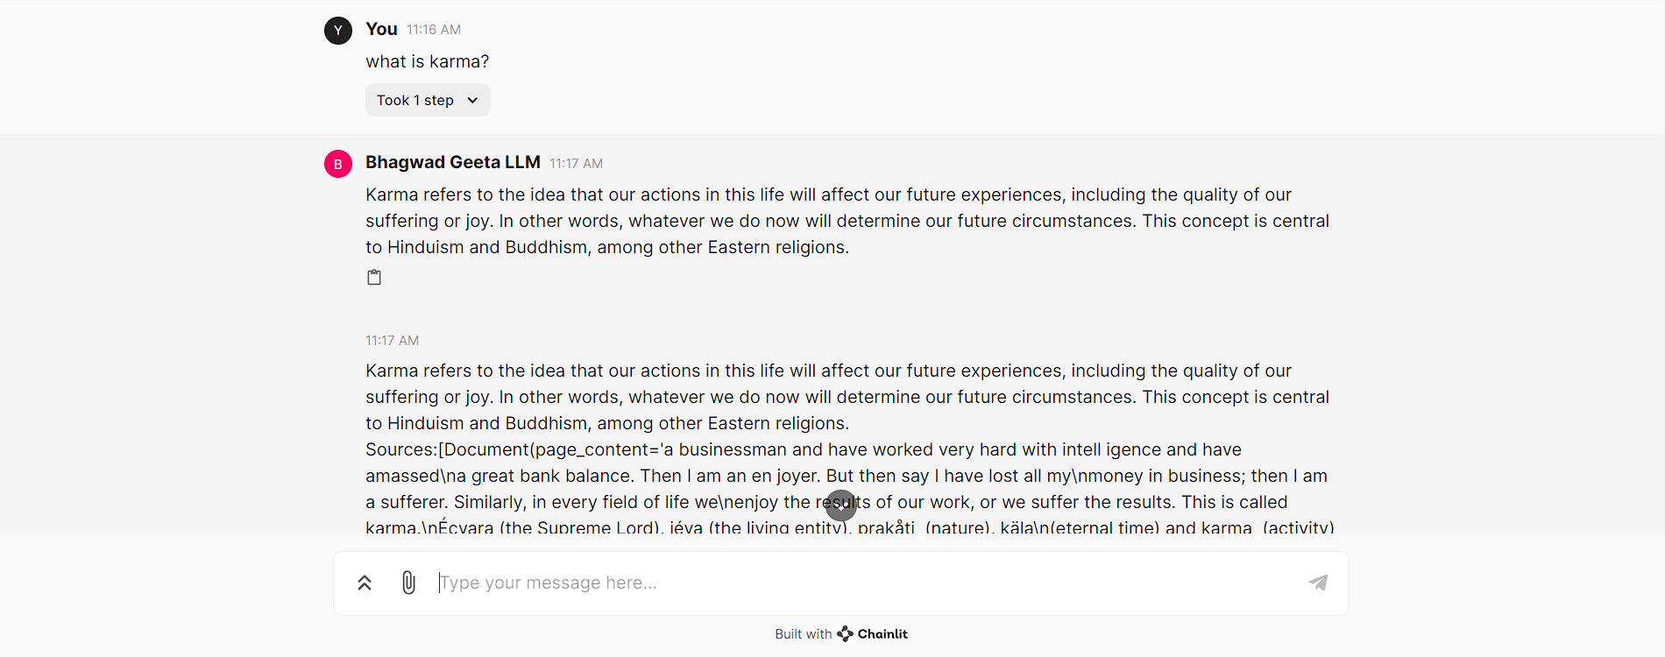
Implementation

Slide 15
Contributions to the Field
Linguistic capabilities of Llama2 model can improve significantly for religious texts.
Models can understand and interpret all the nuances of a philosophical and linguistic ideas of Bhagavad Gita.
Research can contribute to the growing field of digital humanities within religious studies by leveraging computational tools for textual analysis, annotation, and visualization of sacred texts like the Bhagavad Gita.
Research could result in the development of educational resources, including annotated editions, linguistic databases, and interactive tools, to support scholars and students studying the Bhagavad Gita from both linguistic and religious perspectives.

Slide 16
Limitations
Currently, model is not able to generate texts in Sanskrit.
Human Feedback is not enabled yet.
Doesn’t support other types of inputs(speech, vision).

Slide 17
Future Work
Generate Sanskrit shloka corresponding to the response given by the model.
Able to interpret and generate using natural speech.
Implement human feedback for authenticity of the response given by model.

Slide 18
Conclusion
In conclusion, the project aimed to harness the capabilities of LLama 2 to construct a Large Language Model (LLM) specifically tailored to the profound teachings of the Bhagavad Gita. Through meticulous data preparation, leveraging the rich textual content of the scripture, and employing advanced techniques within LLama 2, we successfully crafted a model capable of generating text reflective of the Gita's timeless wisdom.
While no model is without limitations, our LLM exhibited promising results, capturing key themes and nuances inherent in the Bhagavad Gita. Its ability to generate text reflective of the scripture's teachings underscores the potential of language modeling in preserving and disseminating cultural and philosophical heritage.
By leveraging cutting-edge technology to delve into ancient wisdom, we bridge the gap between tradition and innovation, fostering a deeper appreciation for timeless philosophical texts in the digital age. Furthermore, the development of specialized LLMs opens doors to diverse applications, from educational tools to language generation in cultural heritage preservation.

Slide 19
References
Mahabharat AI: https://github.com/CyberAmyntas/mahabharatAI
Gita GPT: https://gitagpt.org/
Ramayana GPT: https://ramayan-gpt.streamlit.app/
Vedic Wisdom: https://chat.openai.com/g/g-YofB1nKXx-vedic-wisdom
Topic Modelling between Bhagavad Gita and Upanishad: https://journals.plos.org/plosone/article?id=10.1371/journal.pone.0273476
Generative AI Language Model Interpret Cultural Heritage Values: https://www.mdpi.com/2673-9585/3/3/32
Sanatan Chatbot: https://sanatanadharma.xyz/?ref=taaft&utm_source=taaft&utm_medium=referral
Sanjaya Chatbot: https://www.messengerx.io/sanjaya?ref=taaft&utm_source=taaft&utm_medium=referral

Slide 20
Acknowledgments
I would like to extend my heartfelt gratitude to Dr. Suchit Purohit for her invaluable guidance, expertise, and unwavering support throughout the duration of this project. Dr. Purohit's profound insights, scholarly wisdom, and dedication to the pursuit of knowledge have been instrumental in shaping the direction and outcomes of our endeavor. Her mentorship has not only enriched the project but also inspired personal and professional growth. I am deeply thankful for Dr. Purohit's contributions and honored to have had the opportunity to collaborate with such a distinguished scholar.

Slide 21
Thank You

